Slide 1

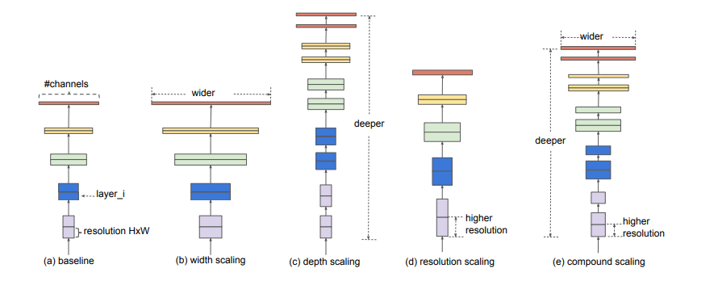
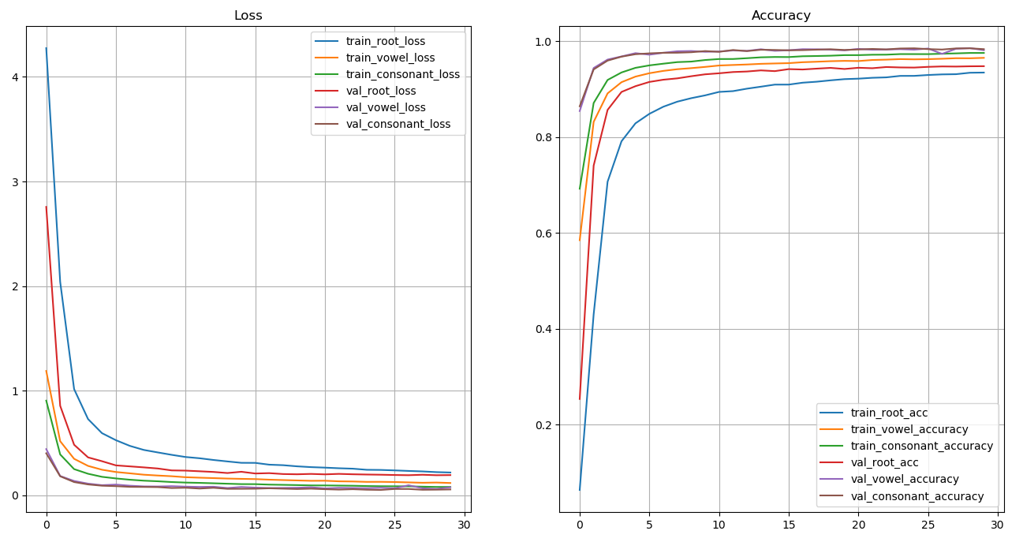
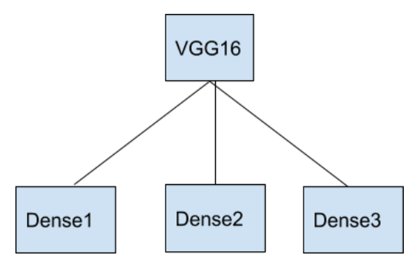
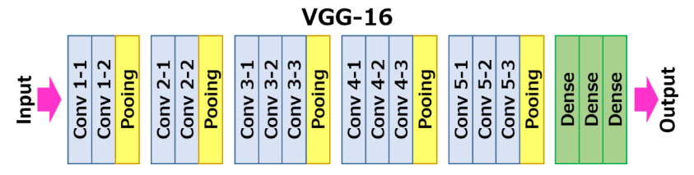
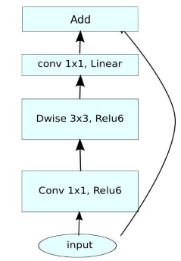
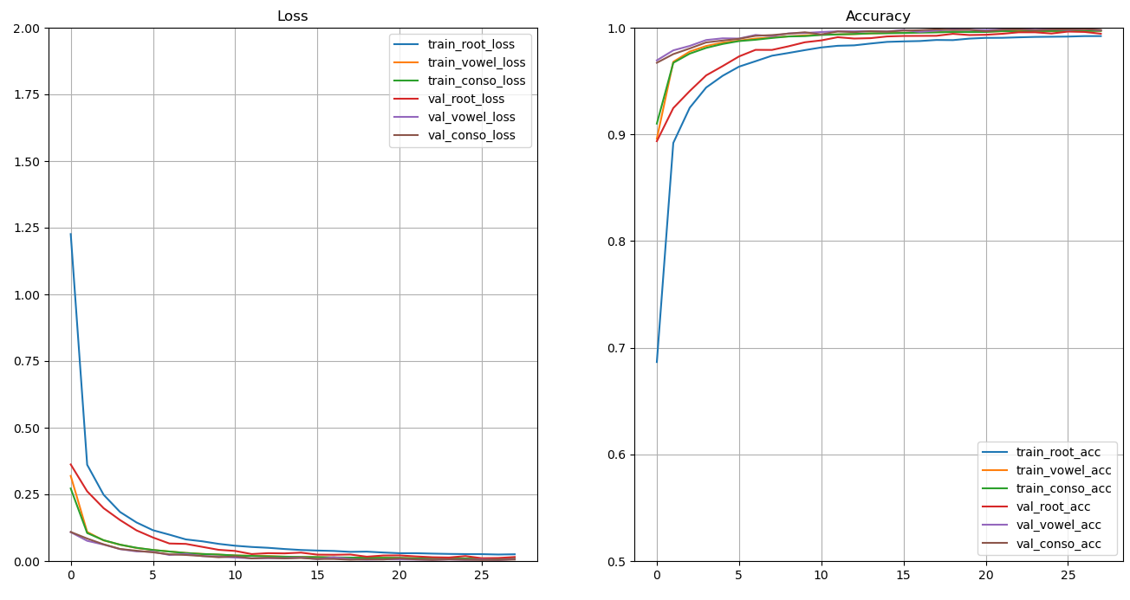
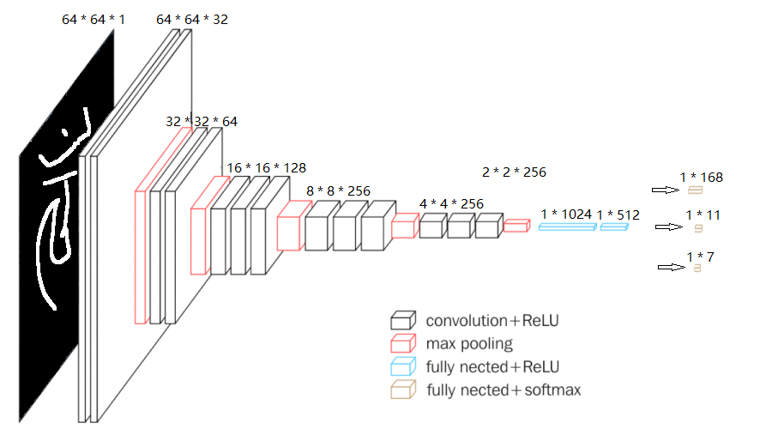
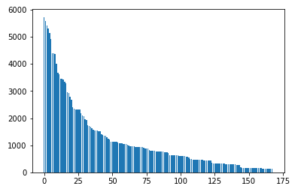
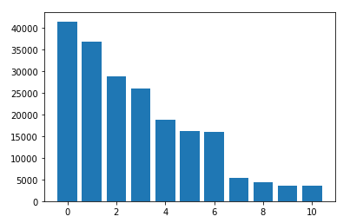
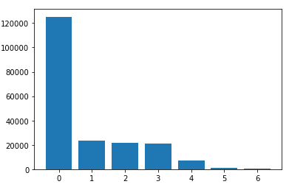
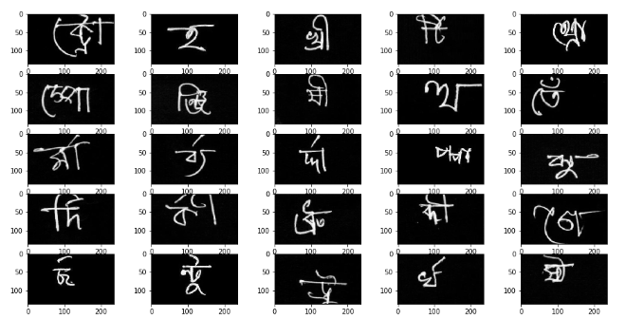
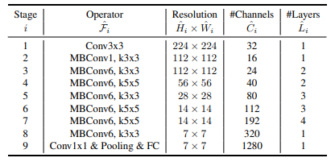
Bengali.AI Handwritten Grapheme Classification
Yueqin Liang, Manyang Sun, Xiaosong Wen, Yu Zhai
Professor: Yanhua Li
Motivation
Methodology
Results
Bengali is the 5th most spoken language in the world with 228 million native speakers and 37 million as second language speakers. It is the national and official language of Bangladesh and the second most popular language in India.
Automatic handwriting recognition has many academic and commercial interests.
Although extensive work has been done for English handwritings, Bangla Handwritten character recognition remains largely unsolved due to the presence of many ambiguous handwritten characters and excessively cursive handwriting.
The main challenge in handwritten character recognition is to deal with the enormous variety of handwriting styles by different writers.
VGG16 + Multi-Output
EfficientNet + Multi-Output
VGG16 + Multioutput
Problem Define:
Our project is to classify three components of handwritten Bengali (grapheme root, vowel diacritic, and consonant diacritics) with the image of the handwritten Bengali graphemes from Kaggle (Bengali.AI, 2020). In this project, a set of deep learning neural networks will be discussed and their performance on the application of handwritten Bengali recognition is systematically evaluated.
EfficientNet + Multioutput
Network Configurations
VGG16
Introduction
Roots
Vowel
Consonant
Conclusion
Both the VGG16 and the EfficientNet achieve high accuracy for the classification of the hand-written Bengali characters.
The VGG16 model achieved 97% of macro-averaged recall on the validation set.
The EfficientNet model achieved both higher accuracy and better efficiency over the VGG16. The EfficientNet model could perform 99% macro-averaged recall on the validation set.
EfficientNet
Reference
[1 ] Bengali.AI. (2020, Jan). Bengali.AI Handwritten Grapheme Classification. Retrieved April 2017 from https://www.kaggle.com/c/bengaliai-cv19/overview
[2 ] Karen Simonyan, Andrew Zisserman, Very Deep Convolutional Networks for Large-Scale Image Recognition
[3 ] Mingxing Tan, Quoc V. Le, EfficientNet: Rethinking Model Scaling for Convolutional Neural Networks

